Slide 1
Physiology

Slide 2
Cell physiology
Dr. Noor Kareem

Slide 3
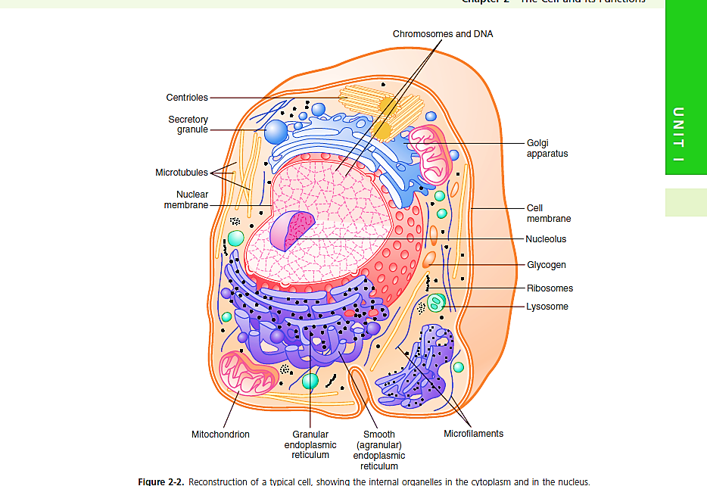

Slide 4
The different substances that make up the cell are collectively called protoplasm. Protoplasm is composed mainly of five basic substances: water, electrolytes, proteins, lipids, and carbohydrates.
Water (70-85%)
Proteins (10-20%)
Lipids ( 2% (mainly phospholipis & cholesterol)
Carbohydrates ( 1%)
Electrolytes (potassium, magnesium, phosphate, sulfate, bicarbonate, and small quantities of sodium, chloride, and calcium)

Slide 5
Cell Membrane
The cell membrane (also called the plasma membrane) envelops the cell and is a thin, pliable, elastic structure only 7.5 to 10 nanometers thick.
It is composed almost entirely of proteins and lipids. The approximate composition is proteins, 55 percent; phospholipids, 25 percent; cholesterol, 13 percent; other lipids, 4 percent; and carbohydrates, percent.

Slide 6
Its basic structure is a lipid bilayer, which is a thin, double-layered film of lipids—each layer only one molecule thick—that is continuous over the entire cell surface. Interspersed in this lipid film are large globular proteins.
The basic lipid bilayer is composed of three main types of lipids: phospholipids, sphingolipids, and cholesterol.
Phospholipids are the most abundant of the cell membrane lipids. One end of each phospholipid molecule is soluble in water; that is, it is hydrophilic. The other end is soluble only in fats; that is, it is hydrophobic.
The phosphate end of the phospholipid is hydrophilic, and the fatty acid portion is hydrophobic.

Slide 7
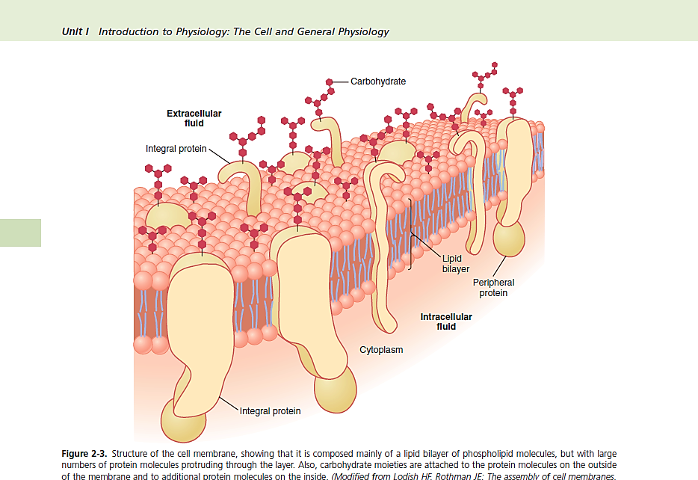

Slide 8
Membrane Carbohydrates—The Cell “Glycocalyx.”
Membrane carbohydrates occur almost invariably in combination with proteins or lipids in the form of glycoproteins or glycolipids.
In fact, most of the integral proteins are glycoproteins, and about one tenth of the membrane lipid molecules are glycolipids.
The carbohydrate moieties attached to the outer surface of the cell have several important functions:
1. Many of them have a negative electrical charge, which gives most cells an overall negative surface charge that repels other negatively charged objects.

Slide 9
2. The glycocalyx of some cells attaches to the glycocalyx of other cells, thus attaching cells to one another.
3. Many of the carbohydrates act as receptor substances for binding hormones, such as insulin; when bound, this combination activates attached internal proteins that, in turn, activate a cascade of intracellular enzymes.
4. Some carbohydrate moieties enter into immune

Slide 10
Integrel proteins | Peripheral proteins
Ion channels proteins Pumps Transport proteins (carriers) Receptors Cell adhesion molecules Antigens & recognition proteins Enzymes | Regulatory proteins Enzymes Anchoring

Slide 12
The general characteristics of transmembrane ion channel proteins:
[1] Specificity
[2] They are either open channels or gated channels (i.e. can be opened or closed by gates Voltage gating (voltage-gated channel)
(B) Chemical or ligand gating (chemical or ligand-gated channel)
(D) Physical gating (physical-gated channel)

Slide 13
The receptors: They are proteins or glycoproteins. They are located on the surface of cell, or within the cytoplasm or nucleus. Receptors have the properties of:
ʘ Specificity
ʘ High affinity
ʘ Limited capacity
ʘ Down & up-regulation
Classification of cell membrane receptors:
1. Gated channel-linked receptors
2. Catalysis-linked receptors
3. G-protein-linked receptors

Slide 14
Cell-to-Cell Adhesions:
[A] Cell adhesion molecules (CAMs): They are integral membrane proteins that have cytoplasmic, transmembrane and extracellular domains.
Immunoglobulin-like adhesion molecules
Integrins,
Cadherins,
Selectins.
[B] The extracellular matrix (ECM, biological “glue”):
Gel (ground substance )+ Protein fibers
Collagen flexible non-elastic fibers
Elastin flexible elastic fibers
[C] Specialized membrane junctions:
Tight junction
Gap junctions finally Adheren or Desmosome junctions

Slide 17
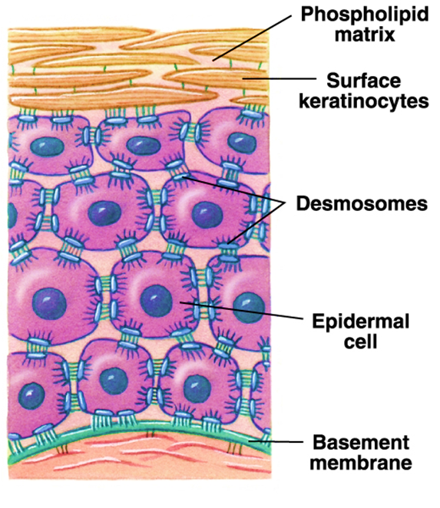

Slide 18
CYTOPLASM AND ITS ORGANELLES
The cytoplasm is filled with both minute and large dispersed particles and organelles. The jelly-like fluid portion of the cytoplasm in which the particles are dispersed is called cytosol and contains mainly dissolved proteins, electrolytes, and glucose.
Dispersed in the cytoplasm are neutral fat globules, glycogen granules, ribosomes, secretory vesicles, and five especially important organelles:
The endoplasmic reticulum, the Golgi apparatus, mitochondria, lysosomes, and peroxisomes.

Slide 19
Endoplasmic Reticulum
a network of tubular and flat vesicular structures in the cytoplasm, which is the endoplasmic reticulum. This organelle helps process molecules made by the cell and transports them to their specific destinations inside or outside the cell. The tubules and vesicles interconnect. Also, their walls are constructed of lipid bilayer membranes that contain large amounts of proteins, similar to the cell membrane.
Ribosomes and the Granular Endoplasmic Reticulum.
Attached to the outer surfaces of many parts of the endoplasmic reticulum are large numbers of minute granular particles called ribosomes. Where these particles are present, the reticulum is called the granular endoplasmic reticulum.

Slide 20
The ribosomes are composed of a mixture of RNA and proteins, and they function to synthesize new protein molecules in the cell
The agranular reticulum functions for the synthesis of lipid substances and for other processes of the cells promoted by intrareticular enzymes.
is closely related to the endoplasmic reticulum. It has membranes similar to those of the agranular endoplasmic reticulum.
Other Functions of the Endoplasmic Reticulum. Other
significant functions of the endoplasmic reticulum, especially the smooth reticulum, include the following:

Slide 21
1. It provides the enzymes that control glycogen breakdown when glycogen is to be used for energy.
2. It provides a vast number of enzymes that are capable of detoxifying substances, such as drugs, that might damage the cell. It achieves detoxification by coagulation, oxidation, hydrolysis, conjugation with glycuronic acid, and in other ways.

Slide 22
The Golgi apparatus is usually composed of four or more stacked layers of thin, flat, enclosed vesicles lying near one side of the nucleus.
This apparatus is prominent in secretory cells, where it is located on the side of the cell from which the secretory substances are extruded.
The Golgi apparatus functions in association with the endoplasmic reticulum.

Slide 24
small “transport vesicles” (also called endoplasmic reticulum vesicles, or ER vesicles) continually pinch off from the endoplasmic reticulum and shortly thereafter fuse with the Golgi apparatus.
In this way, substances entrapped in the ER vesicles are transported from the endoplasmic reticulum to the Golgi apparatus.
The transported substances are then processed in the Golgi apparatus to form lysosomes, secretory vesicles, and other cytoplasmic components.

Slide 25
Also, formation of large saccharide polymers bound with small amounts of protein; important examples include hyaluronic acid and chondroitin sulfate.
the many functions of hyaluronic acid and chondroitin sulfate in the body are as follows:
(1) they are the major components of proteoglycans secreted in mucus and other glandular secretions;
(2) they are the major components of the ground substance, or nonfibrous components of the extracellular matrix, outside the cells in the interstitial spaces, acting as fillers between collagen fibers and cells;
(3) they are principal components of the organic matrix in both cartilage and bone;
(4) they are important in many cell activities, including migration and proliferation.

Slide 26
Lysosomes
are vesicular organelles that form by breaking off from the Golgi apparatus and then dispersing throughout the cytoplasm.
The lysosomes provide an intracellular digestive system that allows the cell to digest (1) damaged cellular structures, (2) food particles that have been ingested by the cell, and (3) unwanted matter such as bacteria.

Slide 27
Hydrolytic enzymes are highly concentrated in lysosomes. Ordinarily, the membrane surrounding the lysosome prevents the enclosed hydrolytic enzymes from coming in contact with other substances in the cell and therefore prevents their digestive actions.
However, some conditions of the cell break the membranes of some of the lysosomes, allowing release of the digestive enzymes. These enzymes then split the organic substances with which they come in contact into small, highly diffusible substances such as amino acids and glucose.

Slide 28
Peroxisomes
Peroxisomes are similar physically to lysosomes
but they are different in two important ways.
First, they are believed to be formed by self-replication (or perhaps by budding off from the smooth endoplasmic reticulum) rather than from the Golgi apparatus.
Second, they contain oxidases rather than hydrolases. Several of the oxidases are capable of combining oxygen with hydrogen ions derived from different intracellular chemicals to form hydrogen peroxide (H2O2).

Slide 29
Hydrogen peroxide is a highly oxidizing substance and is used in association with catalase,
Another oxidase enzyme present in large quantities in peroxisomes, to oxidize many substances that might otherwise be poisonous to the cell.
For instance, about half the alcohol a person drinks is detoxified into acetaldehyde by the peroxisomes of the liver cells in this manner.
A major function of peroxisomes is to catabolize long chain fatty acids.

Slide 30
Mitochondria
The mitochondria are called the “powerhouses” of the cell. Without them, cells would be unable to extract enough energy from the nutrients, and essentially all cellular functions would cease.
Mitochondria are present in all areas of each cell’s cytoplasm, but the total number per cell varies from less
than a hundred up to several thousand, depending on the amount of energy required by the cell.
The cardiac muscle cells (cardiomyocytes), for example, use large amounts of energy and have far more mitochondria than do fat cells (adipocytes)

Slide 31
The basic structure of the mitochondrion, is composed mainly of two lipid bilayer–protein membranes: an outer membrane and an inner membrane. Many infoldings of the inner membrane form shelves or tubules called cristae onto which oxidative enzymes are attached.
The cristae provide a large surface area for chemical reactions to occur. In addition, the inner cavity of the mitochondrion is filled with a matrix that contains large quantities of dissolved enzymes that are necessary for extracting energy from nutrients.
Mitochondria are self-replicative, which means that one mitochondrion can form a second one whenever there is a need in the cell for increased amounts of ATP.

Slide 32
Cell Cytoskeleton—Filament and Tubular Structures
The cell cytoskeleton is a network of fibrillar proteins organized into filaments or tubules.
These originate as precursor protein molecules synthesized by ribosomes in the cytoplasm. The precursor molecules then polymerize to form filaments. As an example, large numbers of actin filaments frequently occur in the outer zone of the cytoplasm, called the ectoplasm, to form an elastic support for the cell membrane.
Also, in muscle cells, actin and myosin filaments are organized into a special contractile machine that is the basis for muscle contraction tubulin molecules is used in all cells to construct strong tubular structures, the microtubules.

Slide 33
Thus, a primary function of microtubules is to act as a cytoskeleton, providing rigid physical structures for certain parts of cells. The cytoskeleton of the cell not only determines cell shape but also participates in cell division, allows cells to move, and provides a track-like system that directs the movement of organelles within the cells.

Slide 34
Nucleus
The nucleus, which is the control center of the cell, sends messages to the cell to grow and mature, to replicate, or to die.
Briefly, the nucleus contains large quantities of DNA, which comprise the genes. The genes determine the characteristics of the cell’s proteins, including the structural proteins, as well as the intracellular enzymes that control cytoplasmic and nuclear activities.

Slide 35
The genes also control and promote reproduction of the cell. The genes first reproduce to create two identical sets of genes; then the cell splits by a special process called mitosis to form two daughter cells, each of which receives one of the two sets of DNA genes.
The nuclear membrane, also called the nuclear envelope, is actually two separate bilayer membranes, one inside the other. The outer membrane is continuous with the endoplasmic reticulum of the cell cytoplasm, The nuclear membrane is penetrated by several thousand nuclear pores. Large complexes of protein molecules are attached at the edges of the pores

Slide 36
FUNCTIONAL SYSTEMS OF THE CELL
INGESTION BY THE CELL—ENDOCYTOSIS
If a cell is to live and grow and reproduce, it must obtain nutrients and other substances from the surrounding fluids. Most substances pass through the cell membrane by diffusion and active transport.
Diffusion involves simple movement through the membrane caused by the random motion of the molecules of the substance; substances move either through cell membrane pores or, in the case of lipid-soluble substances, through the lipid matrix of the membrane.
Active transport involves the actual carrying of a substance through the membrane by a physical protein structure that penetrates all the way through the membrane. These active transport mechanisms are so important to cell function

Slide 37
Very large particles enter the cell by a specialized function of the cell membrane called endocytosis.
The principal forms of endocytosis are pinocytosis and phagocytosis.
Pinocytosis means ingestion of minute particles that form vesicles of extracellular fluid and particulate constituents inside the cell cytoplasm.
Phagocytosis means ingestion of large particles, such as bacteria, whole cells, or portions of degenerating tissue.

